Slide 1
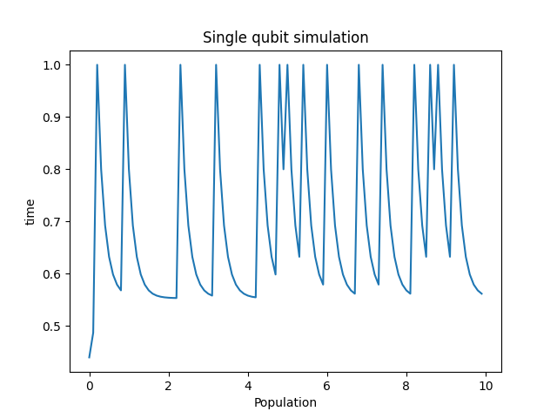
Qubit Dynamics: Introducing to Future Computing Technology
Introduction(This part should give a brief explain about what is quantum computing and what is the qubit)
In quantum computing and information, a qubit is a key building block that represents a two-level quantum system. The property that it can state in a superposition of state 0 and state 1 provide an outstanding ability in storing data in limited space. The Rabi frequency, Ω_R, is the defining characteristic that measures the speed at which qubit states transition due to the influence of external fields.
Key functions and programs
Related coding and programs
Connection with other projects
(This part should state the related part of technologies )
Error corrections
Superconductivity with quantum computing
Latest News:
(This part should contain some encouraging developments in the recent world.)
Picture of realisation
references

